Slide 1

CSC4202-G6:
DESIGN AND ANALYSIS OF ALGORITHMS
(SAFE EVACUATION ROUTE IN POST-LANDSLIDE)
ALISYA ATHIRAH BINTI MOHD HUZZAINNY 211175
ADRIANA HUMAYRA BINTI SHALIZAN 213056
NURHAZWANI BINTI MUHAMMAD RADHI 213515

Slide 2

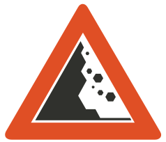

Scenario & Challenge
A catastrophic landslide struck around The Mines Shopping Mall in Seri Kembangan, resulting in significant structural damage and blocking several pathways. This unexpected disaster has trapped numerous individuals inside, including ten Universiti Putra Malaysia (UPM) students. These students must find safe routes to return to their college dormitory, Kolej 12, on the university campus. The usual fastest routes are now unsafe, so they need to consider alternative paths that offer the shortest distance while ensuring their safety.
The primary challenges are:
navigating blocked roads and paths
dealing with the dynamically changing conditions caused by the landslide
ensuring the safety of the individuals

Slide 3
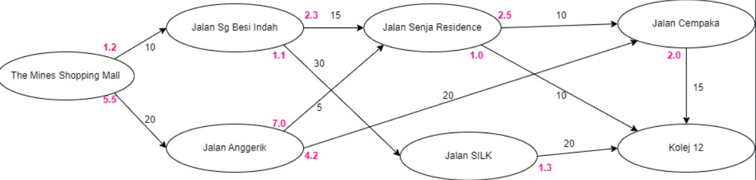
Goal
To develop an algorithm that helps the students to find the shortest and safest routes to reach Kolej 12. Compare each route distance and safety score from each Jalan stated in the illustration above. The starting location is The Mines Shopping Mall.

Slide 4




Algorithm Chosen
Algorithm Paradigm: The paradigm used for Dijkstra's algorithm is greedy algorithm.
Why choose Dijkstra’s algorithm??
Effectiveness in handling graph-based pathfinding problems that require optimization of multiple factors
Ability to provide real-time, optimal solutions based on the evolving landscape

Slide 5
Pseudocode
function findSafestPath(start: Location, destination: Location)
start.minDistance = 0
queue = new PriorityQueue()
queue.add(start)
while queue is not empty
current = queue.poll()
for each path in current.paths
next = path.target
weight = path.distance + path.safetyScore
distanceThroughCurrent = current.minDistance + weight
if distanceThroughCurrent < next.minDistance
queue.remove(next)
next.minDistance = distanceThroughCurrent
next.previous = current
queue.add(next)
printPaths(destination)
Uses a priority queue to always expand the least-cost (safest) node first.
Updates the shortest known distance to each neighboring location and tracks the path taken.
function getPathTo(target: Location) -> List of Location
path = new List()
location = target
while location is not null
path.add(location)
location = location.previous
reverse(path)
return path
Reconstructs the path from the destination back to the start by following the previous pointers.
Provides the sequence of locations that form the safest path.

Slide 6
Pseudocode
function main()
mall = new Location("The Mines Shopping Mall")
kolej12 = new Location("Kolej 12")
checkpoint1 = new Location("Jalan Sg Besi Indah")
checkpoint2 = new Location("Jalan Anggrerik")
checkpoint3 = new Location("Jalan Senja Residence")
checkpoint4 = new Location("Jalan SILK")
checkpoint5 = new Location("Jalan Cempaka")
addPaths(mall, [
new Path(checkpoint1, 10, 1.2),
new Path(checkpoint2, 20, 5.5)
])
addPaths(checkpoint1, [
new Path(checkpoint3, 15, 2.3),
new Path(checkpoint4, 30, 1.1)
])
addPaths(checkpoint2, [
new Path(checkpoint3, 5, 7.0),
new Path(checkpoint5, 25, 4.2)
])
addPaths(checkpoint3, [
new Path(kolej12, 10, 1.0),
new Path(checkpoint5, 10, 2.5)
])
addPaths(checkpoint4, [
new Path(kolej12, 20, 1.3)
])
addPaths(checkpoint5, [
new Path(kolej12, 15, 2.0)
])
findSafestPath(mall, kolej12)

Slide 7
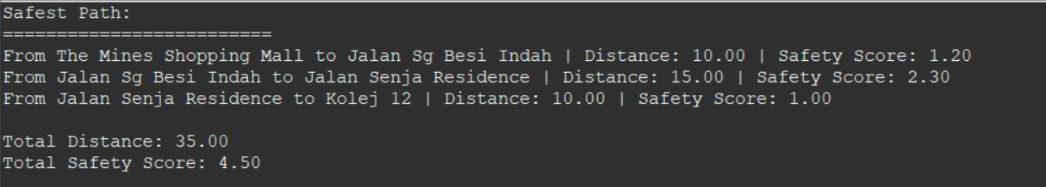
Output

Slide 8
Correctness Analysis
Initialization
Recurrence Relation
start.minDistance = 0
Initialize priority queue and add the start location to it.
Ensures the search begins from the start location with the appropriate initial distance.
If total_distance(v) is less than minDistance(v), then: minDistance(v)=total_distance(v)
Iterate and update the shortest path estimate for each location based on the current shortest known paths.
Ensures that the shortest known path to each location is continually improved.
Optimization Function
minDistance(v)=min(minDistance(v),minDistance(u)+w)
Expanding the smallest minDistance ensures correct order processing.
This guarantees the shortest path from The Mines Shopping Mall to Kolej 12.

Slide 9
Algorithm Analysis cont..
Best-case analysis
Dijkstra's algorithm needs to process each vertex and edge at least once, and the priority queue operations (insertions and deletions) still take O(log⁡V) time.
Time Complexity: O((V+E)log⁡V)
Vertices (V): The number of locations.
Edges (E): The number of paths.
The factor log⁡V comes from the operations on the priority queue.
Average-case analysis
Dijkstra's algorithm will typically process each vertex and edge.
Time Complexity: O((V+E)log⁡V)
Worst-case analysis
Every vertex and every edge needs to be processed. Each insertion and deletion operation in the priority queue takes O(log⁡V) time.
Time Complexity: O((V+E)log⁡V)

Slide 10
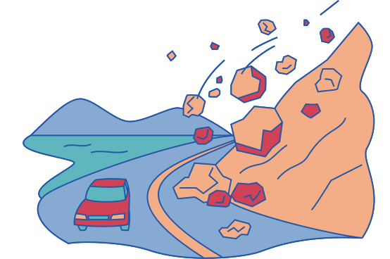
Thank you

